Slide 1
BASIC ELEMENTARY DATA sTRUCTURES

Slide 2
Data Structures
Data + Structure = Data Structure
The logical or mathematical model of particular organization of data is known as Data Structure. It is the organized collection of data.
The data structure is a process of how the data items are organized in computer memory for the processing.

Slide 3
Types of data structures

Slide 4
Types of Data Structures
Data Structures
Linear Non-Linear
Elements form Sequence
Elements do not form Sequence
Arrays
Linked- Lists
Stacks
Queues
Trees
Graphs

Slide 5
Types of Data Structures
Arrays:
The simplest type of Data Structures is a linear array. By linear array we mean a list of finite number n of similar data elements, usually 1,2,3,4,…….,n
Linked Lists:
Linked List is a collection of nodes. Each node is divided into two parts. First part contains the info of the data item and the second part contains the pointer to the next node

Slide 6
Types of Data Structures
Stacks:
A Stack, also called Last-In-First-Out(LIFO) system, is a linear list in which insertions and deletions can take place only at one end “top”
Queues:
A Queue, also called First-In-First-Out(FIFO) system, is a linear list in which deletions can take place only at one end “front” and insertions can take place at the other end “rear”

Slide 7
Types of Data Structures
Trees:
Trees are non-linear data structure used to represent the data containing a hierarchical relationship between elements, e.g., records, family trees, and tables of contents
Graphs:
A Graph is a non-linear data structure having a set V of elements called nodes and set E of edges such that each edge e is identified with a unique pair [u,v] of nodes in V, denoted by e=[u,v]

Slide 8
Operations on data structures

Slide 9
Operations on Data Structures
The Data appearing in our Data Structures are processed by means of certain operations
Traversing:
Accessing each record exactly once so that certain items in the record may be processed
Inserting:
Adding a new record to the Structure
Deleting:
Removing a record from the Structure

Slide 10
Operations on Data Structures
Sorting:
Arranging the records in some logical order
Searching:
Finding the location of the record with a given key value, or finding the locations of all records which satisfy one or more conditions
Merging:
Combining the records in two different sorted files into a single sorted file

Slide 11
Algorithmic complexity

Slide 12
Algorithmic Complexity
An algorithm is a sequence of steps that gives method of solving a problem. It creates the logic of program. Efficiency of program depends on two major criteria, first one is run time of that algorithm and second is the space.
Runtime of algorithm means the time taken by the program for execution. We implement different data structures, some data structures take more space but improves the runtime and some takes less space but it effects runtime of algorithm.

Slide 13
Algorithmic Complexity
1.Best Case: In this case, algorithm searches the element in first time itself. Ex- Searching with linear search.
2.Average Case: In average case we take the probability with list of data. Average case of algorithm should be the average number of steps but since data can be at any place, so finding exact behavior of algorithm is difficult.
3.Worst Case: In this case we find the element at the end or when searching of element fails.

Slide 14
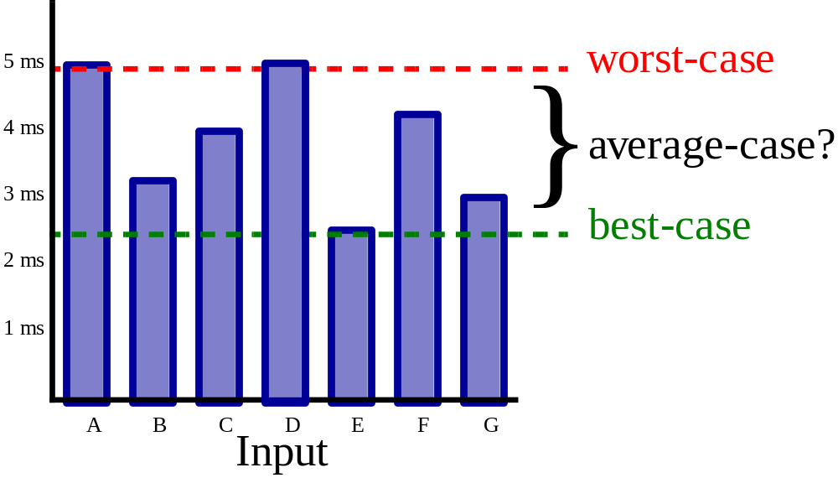
Algorithmic Complexity

Slide 15
Algorithmic Complexity
The complexity of an algorithm M is the function f(n) which gives the running time and/or storage space requirement of the algorithm in terms of the size n of the input data. Frequently, the storage space required by an algorithm is simply a multiple of the data size n.

Slide 16
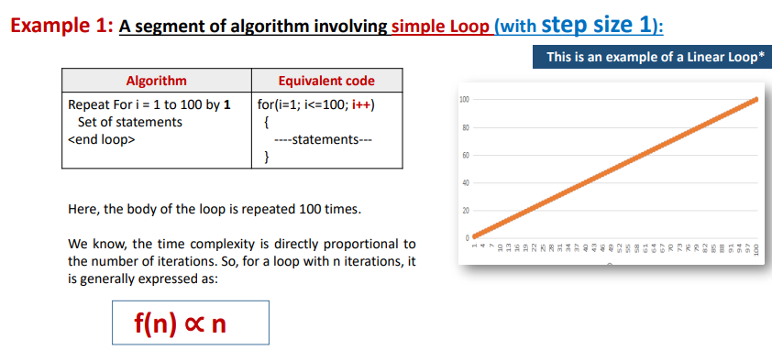


Slide 17
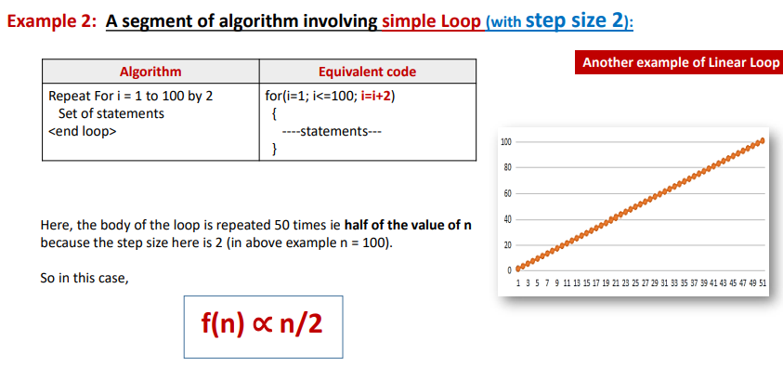

Slide 18
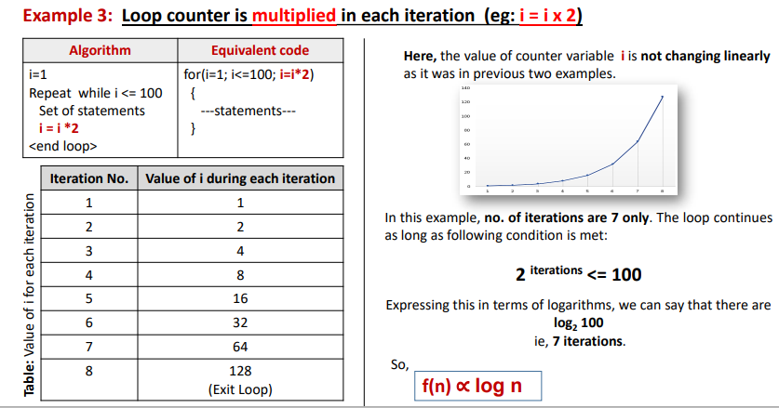

Slide 19
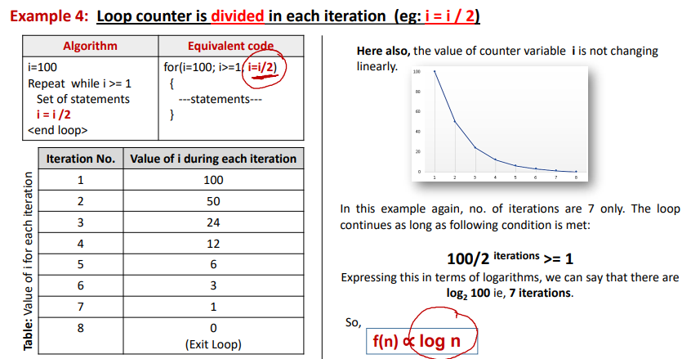

Slide 20
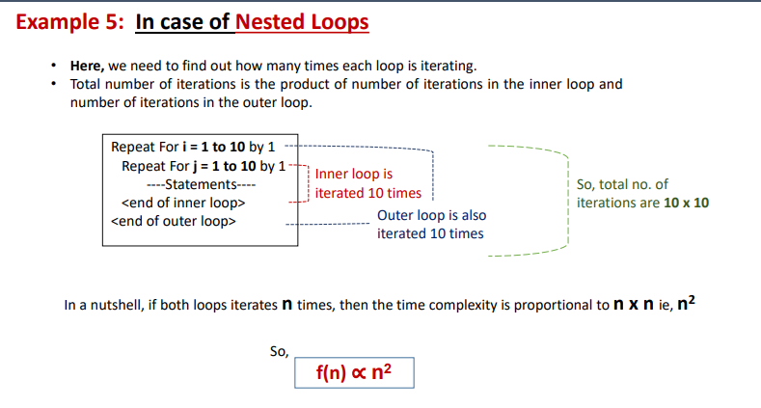

Slide 21
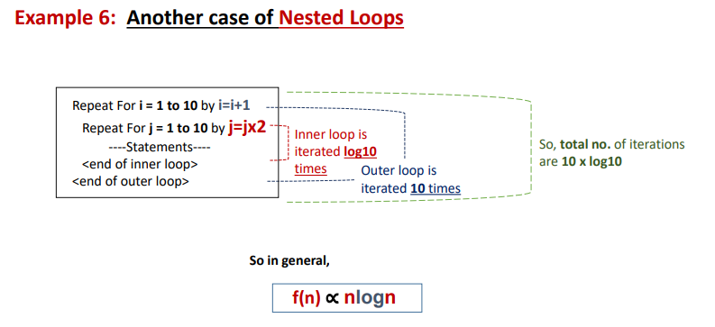

Slide 22
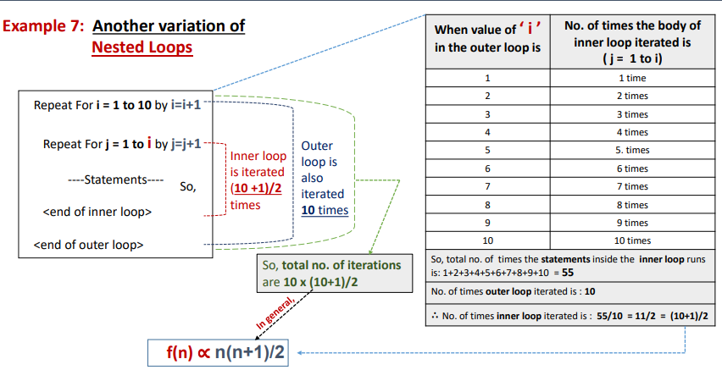

Slide 23
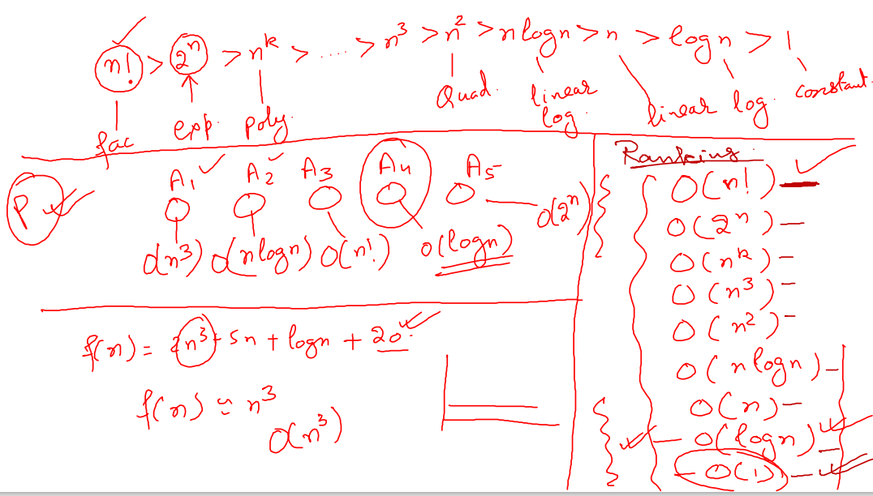
GROWTH OF FUNCTIONS

Slide 24
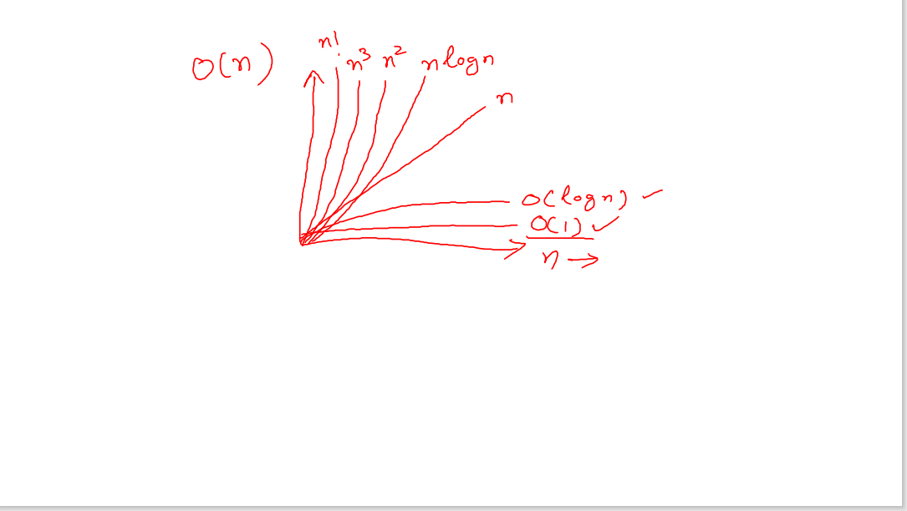

Slide 25
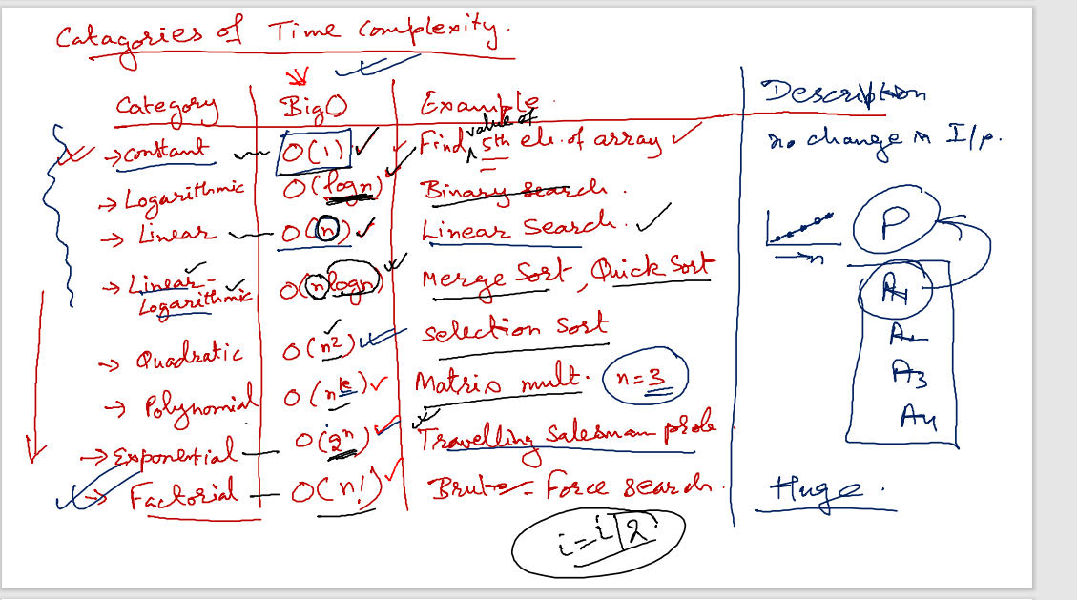
Growth of functions

Slide 26
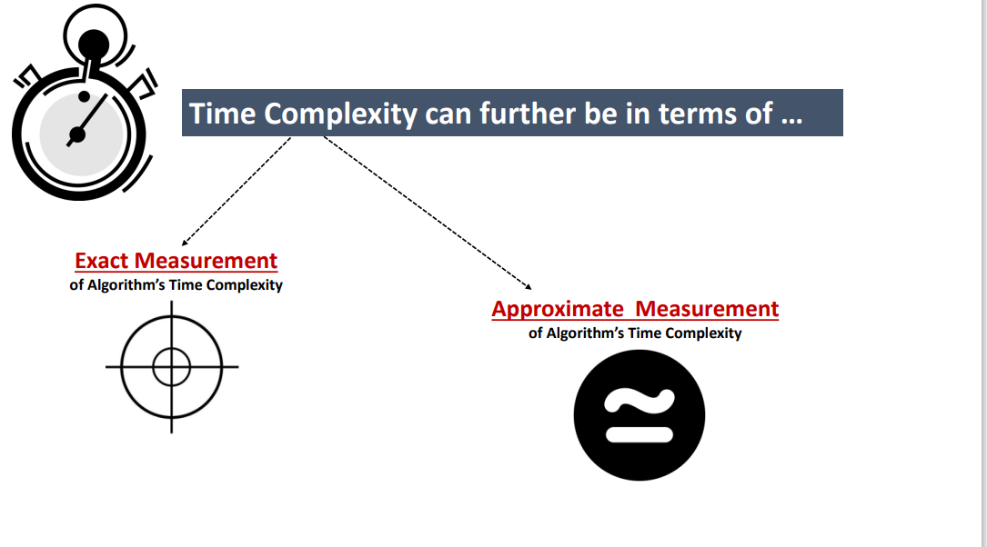

Slide 27
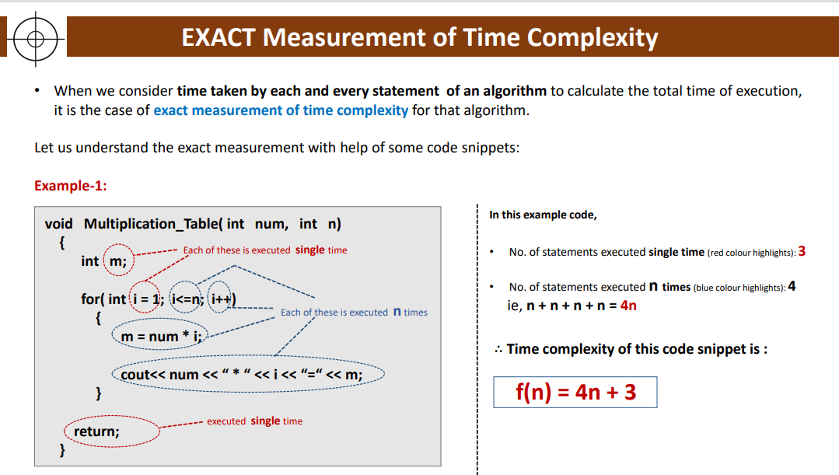

Slide 28
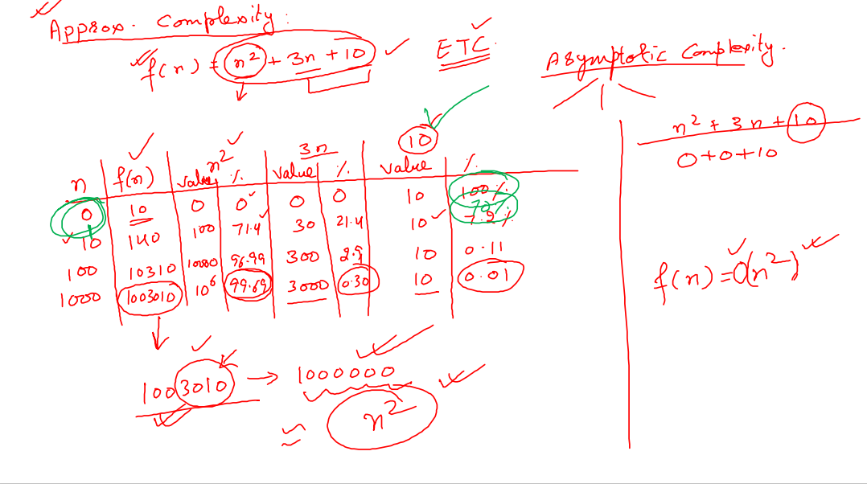

Slide 29
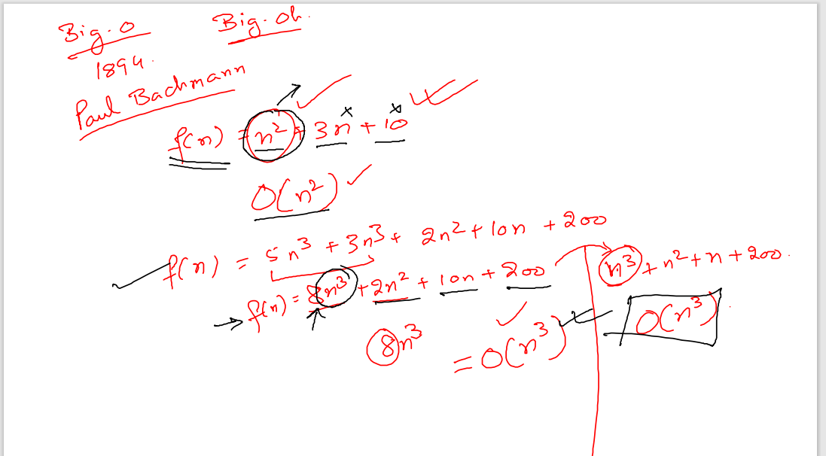

Slide 30
Asymptotic Notations
The commonly used asymptotic notations used for calculating the running time complexity of an algorithm is given below:
Big oh Notation (?)
Omega Notation (Ω)
Theta Notation (θ)

Slide 31
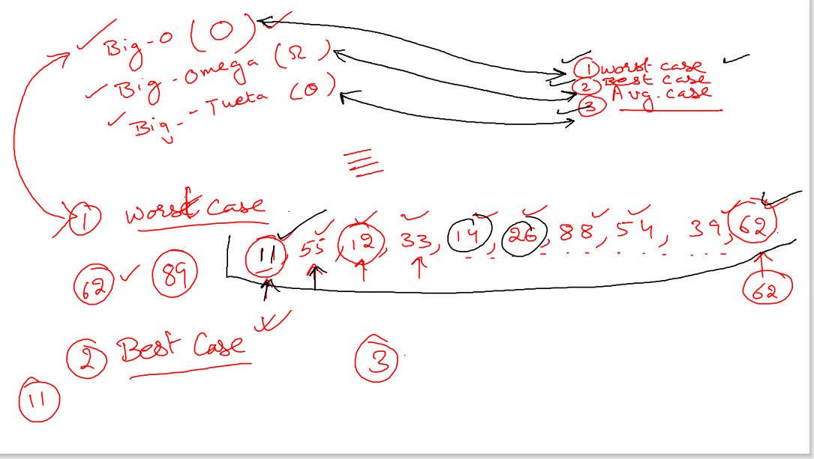

Slide 32
Suppose we have an array of five elements, and we want to add a new element at the beginning of the array. To achieve this, we need to shift each element towards right, and suppose each element takes one unit of time. There are five elements, so five units of time would be taken. Suppose there are 1000 elements in an array, then it takes 1000 units of time to shift. It concludes that time complexity depends upon the input size.
Therefore, if the input size is n, then f(n) is a function of n that denotes the time complexity.

Slide 33
Why we have three different asymptotic analysis?
As we know that big omega is for the best case, big oh is for the worst case while big theta is for the average case. Now, we will find out the average, worst and the best case of the linear search algorithm.
Suppose we have an array of n numbers, and we want to find the particular element in an array using the linear search. In the linear search, every element is compared with the searched element on each iteration. Suppose, if the match is found in a first iteration only, then the best case would be Ω(1), if the element matches with the last element, i.e., nth element of the array then the worst case would be O(n). The average case is the mid of the best and the worst-case, so it becomes θ(n/1). The constant terms can be ignored in the time complexity so average case would be θ(n).
So, three different analysis provide the proper bounding between the actual functions. Here, bounding means that we have upper as well as lower limit which assures that the algorithm will behave between these limits only, i.e., it will not go beyond these limits.

Slide 34
Big oh Notation (O)
Big O notation is an asymptotic notation that measures the performance of an algorithm by simply providing the order of growth of the function.
This notation provides an upper bound on a function which ensures that the function never grows faster than the upper bound. So, it gives the least upper bound on a function so that the function never grows faster than this upper bound.
It is the formal way to express the upper boundary of an algorithm running time. It measures the worst case of time complexity or the algorithm's longest amount of time to complete its operation. It is represented as shown below:

Slide 35
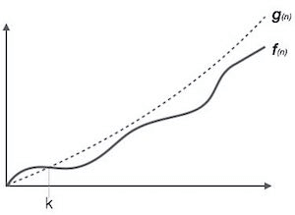
For example:
If f(n) and g(n) are the two functions defined for positive integers,
then f(n) = O(g(n)) as f(n) is big oh of g(n) or f(n) is on the order of g(n)) if there exists constants c and no such that:
f(n)≤c.g(n) for all n≥no

Slide 36
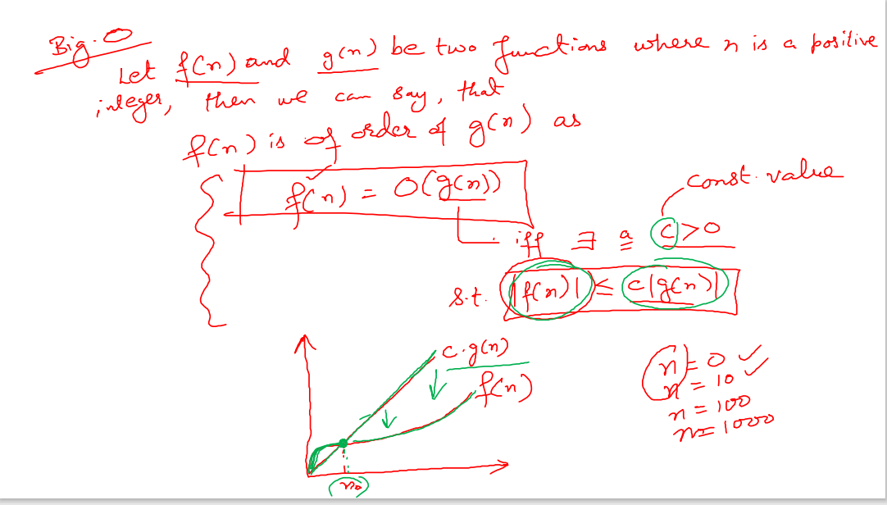

Slide 38
This implies that f(n) does not grow faster than g(n), or g(n) is an upper bound on the function f(n). In this case, we are calculating the growth rate of the function which eventually calculates the worst time complexity of a function, i.e., how worst an algorithm can perform.
Let's understand through examples
Example 1: f(n)=2n+3 , g(n)=n
Now, we have to find Is f(n)=O(g(n))?
To check f(n)=O(g(n)), it must satisfy the given condition:
f(n)<=c.g(n)
First, we will replace f(n) by 2n+3 and g(n) by n.
2n+3 <= c.n
Let's assume c=5, n=1 then
2*1+3<=5*1
5<=5
For n=1, the above condition is true.
If n=2
2*2+3<=5*2
7<=10
For n=2, the above condition is true.

Slide 39
We know that for any value of n, it will satisfy the above condition, i.e., 2n+3<=c.n. If the value of c is equal to 5, then it will satisfy the condition 2n+3<=c.n. We can take any value of n starting from 1, it will always satisfy. Therefore, we can say that for some constants c and for some constants n0, it will always satisfy 2n+3<=c.n. As it is satisfying the above condition, so f(n) is big oh of g(n) or we can say that f(n) grows linearly. Therefore, it concludes that c.g(n) is the upper bound of the f(n). It can be represented graphically as:

Slide 40
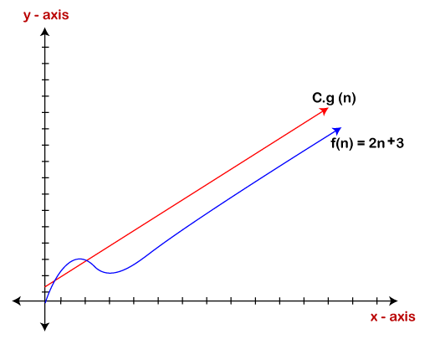

Slide 41
The idea of using big o notation is to give an upper bound of a particular function, and eventually it leads to give a worst-time complexity. It provides an assurance that a particular function does not behave suddenly as a quadratic or a cubic fashion, it just behaves in a linear manner in a worst-case.

Slide 42
Omega Notation (Ω)
It basically describes the best-case scenario which is opposite to the big o notation.
It is the formal way to represent the lower bound of an algorithm's running time. It measures the best amount of time an algorithm can possibly take to complete or the best-case time complexity.
It determines what is the fastest time that an algorithm can run.

Slide 43
If we required that an algorithm takes at least certain amount of time without using an upper bound, we use big- Ω notation i.e. the Greek letter "omega". It is used to bound the growth of running time for large input size.
If f(n) and g(n) are the two functions defined for positive integers,
then f(n) = Ω (g(n)) as f(n) is Omega of g(n) or f(n) is on the order of g(n)) if there exists constants c and no such that:
f(n)>=c.g(n) for all n≥no and c>0

Slide 44
Let's consider a simple example.
If f(n) = 2n+3, g(n) = n,
Is f(n)= Ω (g(n))?
It must satisfy the condition:
f(n)>=c.g(n)
To check the above condition, we first replace f(n) by 2n+3 and g(n) by n.
2n+3>=c*n
Suppose c=1
2n+3>=n (This equation will be true for any value of n starting from 1).
Therefore, it is proved that g(n) is big omega of 2n+3 function.

Slide 45
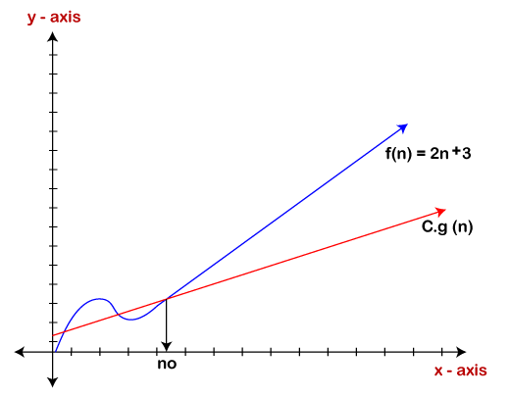

Slide 46
As we can see in the above figure that g(n) function is the lower bound of the f(n) function when the value of c is equal to 1. Therefore, this notation gives the fastest running time. But, we are not more interested in finding the fastest running time, we are interested in calculating the worst-case scenarios because we want to check our algorithm for larger input that what is the worst time that it will take so that we can take further decision in the further process.

Slide 47
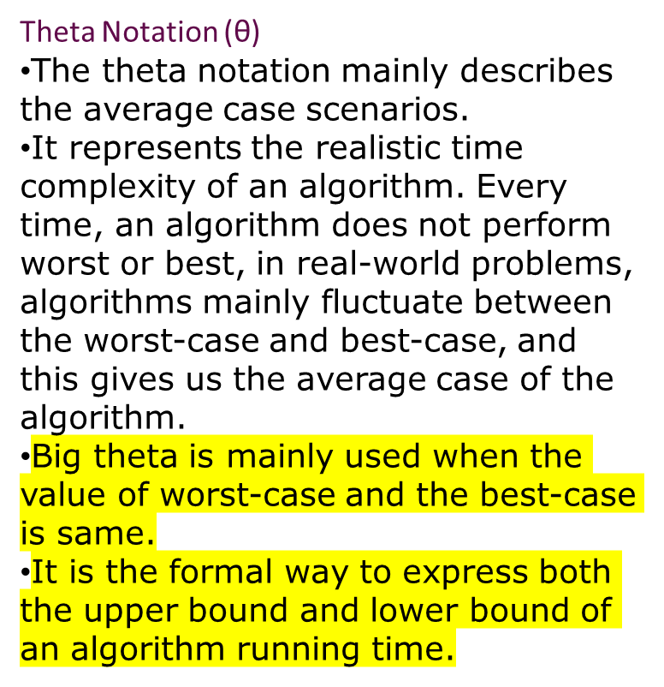

Slide 48
Let's understand the big theta notation mathematically:
Let f(n) and g(n) be the functions of n where n is the steps required to execute the program then:
f(n)= θg(n)
The above condition is satisfied only if when
c1.g(n)<=f(n)<=c2.g(n)
where the function is bounded by two limits, i.e., upper and lower limit, and f(n) comes in between. The condition f(n)= θg(n) will be true if and only if c1.g(n) is less than or equal to f(n) and c2.g(n) is greater than or equal to f(n). The graphical representation of theta notation is given below:

Slide 49
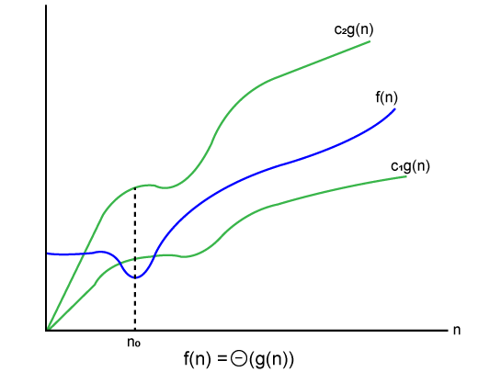

Slide 50
Let's consider the same example where
f(n)=2n+3
g(n)=n
As c1.g(n) should be less than f(n) so c1 has to be 1 whereas c2.g(n) should be greater than f(n) so c2 is equal to 5. The c1.g(n) is the lower limit of the of the f(n) while c2.g(n) is the upper limit of the f(n).
c1.g(n)<=f(n)<=c2.g(n)
Replace g(n) by n and f(n) by 2n+3
c1.n <=2n+3<=c2.n
if c1=1, c2=2, n=1
1*1 <=2*1+3 <=2*1
1 <= 5 <= 2 // for n=1, it satisfies the condition c1.g(n)<=f(n)<=c2.g(n)
If n=2
1*2<=2*2+3<=2*2
2<=7<=4 // for n=2, it satisfies the condition c1.g(n)<=f(n)<=c2.g(n)

Slide 51
Therefore, we can say that for any value of n, it satisfies the condition c1.g(n)<=f(n)<=c2.g(n). Hence, it is proved that f(n) is big theta of g(n). So, this is the average-case scenario which provides the realistic time complexity.

Slide 52
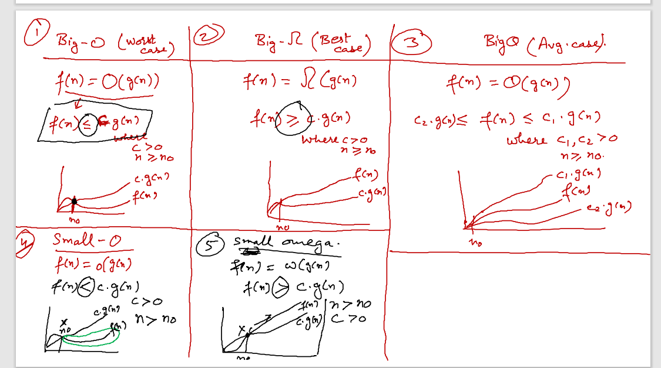

Slide 53
ARRAYS

Slide 54
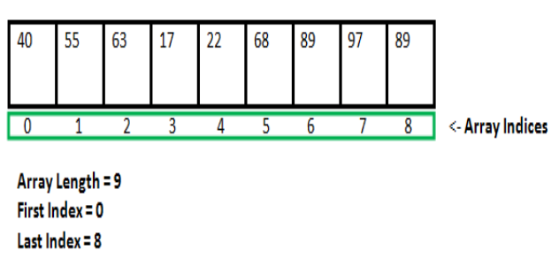
arrays
It is a collection of similar data items stored at contiguous memory locations and elements can be accessed randomly using indices of an array.
They can be used to store collection of primitive data types such as int, float, double, char, etc of any particular type.
Notes:
Insert a map of your country.

Slide 55
Properties of Array
Each element of an array is of same data type and carries the same size, i.e., int = 4 bytes.
Elements of the array are stored at contiguous memory locations where the first element is stored at the smallest memory location.
Elements of the array can be randomly accessed since we can calculate the address of each element of the array with the given base address and the size of the data element
Notes:
Insert a map of your country.

Slide 56
Advantages of arrays
1) Code Optimization: Less code to the access the data.
2) Ease of traversing: By using the for loop, we can retrieve the elements of an array easily.
3) Ease of sorting: To sort the elements of the array, we need a few lines of code only.
4) Random Access: We can access any element randomly using the array.
Notes:
Insert a map of your country.

Slide 57
Declaration of C Array
SYNTAX
data_type array_name[array_size];
int marks[5];
Notes:
Insert a map of your country.

Slide 58
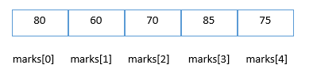
Initialization of C Array
marks[0]=80;//initialization of array
marks[1]=60;
marks[2]=70;
marks[3]=85;
marks[4]=75;
Notes:
Insert a map of your country.

Slide 59
#include<stdio.h>
int main(){
int i=0;
int marks[5];//declaration of array
marks[0]=80;//initialization of array
marks[1]=60;
marks[2]=70;
marks[3]=85;
marks[4]=75;
for(i=0;i<5;i++){
printf("%d \n",marks[i]);
}
}
Notes:
Insert a map of your country.

Slide 60
Declaration with Initialization
int marks[5]={20,30,40,50,60};
In some case, there is no requirement to define the size
int marks[]={20,30,40,50,60};
Notes:
Insert a map of your country.

Slide 61
2D Array
The two-dimensional array can be defined as an array of arrays.
The 2D array is organized as matrices which can be represented as the collection of rows and columns.
Notes:
Insert a map of your country.

Slide 62
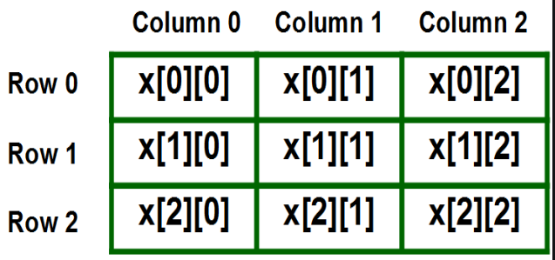
Declaration
We can declare a two-dimensional integer array say ‘x’ of size 3 rows and 4 columns as
int x[3][4];
Notes:
Insert a map of your country.

Slide 63
Initializing Two – Dimensional Arrays:
int x[3][2] = {{0,1}, {2,3}, {4,5}};
Notes:
Insert a map of your country.

Slide 64
#include<stdio.h>
main()
{ int x[3][2] = {{0,1}, {2,3}, {4,5}};
for (int i = 0; i < 3; i++)
{
for (int j = 0; j < 2; j++)
{
printf(" %d ", x[i][j]);
}
}
}
Notes:
Insert a map of your country.

Slide 65
Operations on Arrays

Slide 66
Searching an element in array
#include<stdio.h>
int main()
{ int a[5]={ 22,55,66,22};
int n, element=55, pos=0,i
for(i=0; i<4; i++)
{
if(a[i]==element)
{
printf("%d found at position %d", element, i+1);
return 0;
}
}
printf("%d not found.", element);
return 0;
}
Notes:
Insert a map of your country.

Slide 67
Inserting an element in array
#include <stdio.h>
int main()
{ int n=5;
int arr[n]={ 33,55,77,88,22};
int i, x=99, pos=3;
for (i = 0; i < n; i++)
printf(" %d \n ", arr[i]);
n++;
for (i = n-1; i >= pos; i--)
arr[i] = arr[i - 1];
arr[pos - 1] = x;
printf(" array after insertion \n");
for (i = 0; i < n; i++)
printf(" %d \n ", arr[i]);
}
Notes:
Insert a map of your country.

Slide 68
Deleting an element in array
#include <stdio.h>
int main()
{ int size=5;
int arr[size]={ 33,55,77,88,22};
int i, x=99, pos=3;
for (i = 0; i < size; i++)
printf(" %d \n ", arr[i]);
for(i=pos-1; i<size-1; i++)
{
arr[i] = arr[i + 1];
}
size--;
printf(" array after deletion \n");
for (i = 0; i < size; i++)
printf(" %d \n ", arr[i]);
}
Notes:
Insert a map of your country.

Slide 69
Merging two arrays
#include <stdio.h>
int main()
{ int size1=5,i,size2=5,size3;
int arr1[size1]={ 33,55,77,88,22};
int arr2[size2]={ 3,5,7,8,2};
printf("1st array \n");
for (i = 0; i < size1; i++)
printf(" %d \n ", arr1[i]);
printf("2nd array \n");
for (i = 0; i < size2; i++)
printf(" %d \n ", arr2[i]);
size3=size1+size2;
int arr3[size3];
for(i=0;i<size1;i++)
arr3[i]=arr1[i];
for(i=0;i<size3;i++)
arr3[size1+i]=arr2[i];
printf("3rd array \n");
for (i = 0; i < size3; i++)
printf(" %d \n ", arr3[i]);
}
Notes:
Insert a map of your country.

Slide 70
concatenating two arrays
#include <stdio.h>
int main()
{ int size1=5,i,size2=5,size3;
int arr1[size1]={ 33,55,77,88,22};
int arr2[size2]={ 3,5,7,8,2};
printf("1st array \n");
for (i = 0; i < size1; i++)
printf(" %d \n ", arr1[i]);
printf("2nd array \n");
for (i = 0; i < size2; i++)
printf(" %d \n ", arr2[i]);
size3=size1+size2;
for(i=0;i<size2;i++)
arr1[size1+i]=arr2[i];
printf("concat array \n");
for (i = 0; i < size3; i++)
printf(" %d \n ", arr1[i]);
}
Notes:
Insert a map of your country.

Slide 71
LINKED-LIST

Slide 72
List: List refers to a linear collection of data items.
Linked-List: A linked list or a one way list is a linear collection of data elements called nodes, Where the linear order is given by means of pointers.
Each node in the list is divided in two parts: The first part contains the information and the second contains the address of the next node in the list called link field.
Single Linked List Representation:
The Linked List contains a list pointer variable called start pointer which contains the address of the first node in the list.
The null pointer signals the end of the list.
A special case is the list that has no nodes such a list is called the null list or empty list.
Start
Info
NULL
LINK
Info

Slide 73
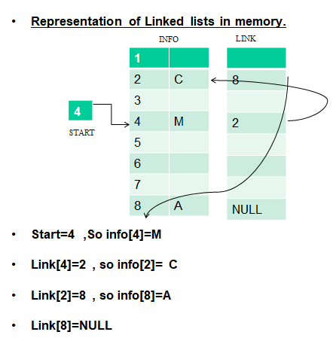

Slide 74
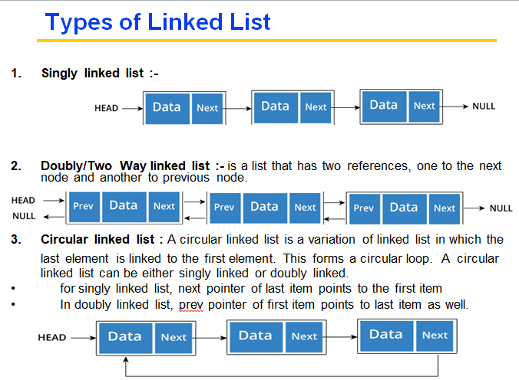

Slide 75
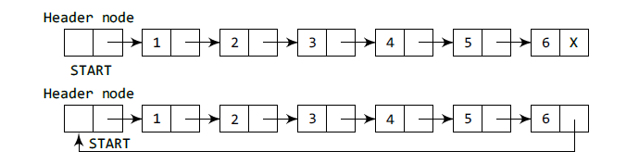
Types of Linked List
Header linked list :- A header linked list is a special type of linked list which contains a header node at the beginning of the list. So, in a header linked list, START will not point to the first node of the list but START will contain the address of the header node.
Grounded header linked list which stores NULL in the next field of the last node.
Circular header linked list which stores the address of the header node in the next field of the last node. Here, the header node will denote the end of the list.

Slide 76
Operations on linked-list:
1) Traversing
2) Insertion
3) Deletion
4) Searching

Slide 77
Insertion at the beginning #include<iostream> using namespace std; int main() { struct node { int data; struct node* link; }; struct node *temp,*head,*last,*temp2; int choice =1; cout<<"inserting at the start of list"<<endl; while(choice==1) { temp = new node(); cout<<"Enter the data of node"; cin>> temp-> data; head=temp; temp->link = head; cout<<"continue"; cin>>choice; } return 0; } | Insertion at the end #include<iostream> using namespace std; int main() { struct node {int data; struct node* link; } *temp,*head,*last,*temp2; int choice=1; last =NULL; cout<<"Inserting at the end of list"; while(choice==1) { temp = new node(); cout<<"Enter the data of node"; cin>> temp->data; if(last==NULL) head=last=temp; else { last->link =temp; last =temp; } cout<<"continue"; cin>>choice; } last->link =NULL; return 0; }

Slide 78
Insertion at the specified location #include<iostream> using namespace std; int main() { struct node { int data; struct node* link; }; struct node *temp,*head,*last,*temp2; int location; last =NULL; cout<<"Enter any location"; cin>>location; temp = new node(); cout<<"Enter the data of node"; cin>> temp->data; temp2=head; while (location-1>0) { location--; temp2=temp2->link; } temp->link =temp2->link; temp2->link=temp; return 0; } | Deletion of the node from any position(start/end) #include<iostream> #include<stdlib.h> //For using free function using namespace std; int main() { struct node {int data; struct node* link; } *temp,*head,*last,*temp2; int location; last =NULL; //First insert the nodes in linked list cout<<"Enter any location"; cin>>location; temp=head; if (location==1) { head =temp->link; free(temp); } else { int i=1; while(i<location-1) { temp =temp->link; i++; } temp2 =temp->link; temp->link = temp2->link; free(temp2); return 0; }

Slide 79
Searching any node #include<iostream> using namespace std; int main() { struct node { int data; struct node* link; }; struct node *temp,*head,*last,*temp2; int value,flag=0; //First insert the nodes in linked list cout<<"Enter value to search"; cin>>value; temp=head; while (temp->link!=NULL) { if(temp->data ==value) { flag =1; break; } else { temp = temp ->link; } } if(flag==1) cout<<“Value found”; else cout<<“Value not in the list”; return 0; } | Traversing a linked list #include<iostream> using namespace std; int main() { struct node {int data; struct node* link; } *temp,*head,*last,*temp2; last =0; //First insert the nodes in linked list temp=head; while(temp!=0) { cout<<temp->data; temp=temp->link; } return 0; }

Slide 80
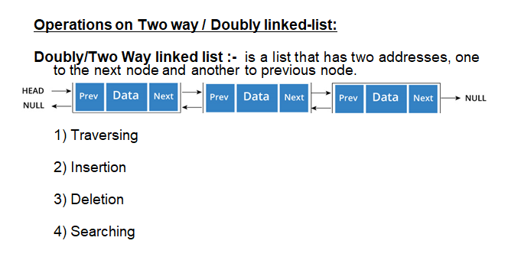

Slide 81
Insertion into doubly linked list #include<iostream> using namespace std; int main() { struct node { int data; struct node* next ; struct node* prev; } *temp,*head,*last,*temp2; int choice=1; last =0; cout<<"Inserting at the end of list"; while(choice==1) { temp = new node(); cout<<"Enter the data of node"; cin>> temp->data; if(last==0) { head=last=temp; temp->prev = 0; temp->next =0; } else{ last->next =temp; temp->prev = last; last=temp; | last->next =0; } cout<<“Do you want to continue?”; cin>>choice; } Forward Traversing temp =head; while(temp!=0) { cout<<temp->data; temp=temp->next; } Backward Traversing temp =last; while(temp!=0) { cout<<temp->data; temp=temp->prev; }

Slide 82
Deletion from two-way linked list #include<iostream> using namespace std; int main() { struct node { int data; struct node* next ; struct node* prev; } *temp,*head,*last,*temp2; int choice=1,position; last =0; // Insert the nodes using the previous code cout<<"delete the node from position "; cout<<"Enter the position"; cin>>position; temp=head; if(position==1) { head =temp->next; free(temp); } | else { int i=1; while(i<position-1) { temp =temp->next; i++; } temp2=temp->next; temp->next = temp2->next; free(temp2); } temp=head; while(temp!=0) { cout<<temp->prev<<" "; cout<<temp->data<<" "; cout<<temp->next<<" "<<endl; temp=temp->next; } return 0; }

Slide 83
Searching from two-way linked list #include<iostream> using namespace std; int main() { struct node { int data; struct node* next ; struct node* prev; } *temp,*head,*last,*temp2; int choice=1,position,value,flag=0; last =0; // Insert the nodes using the previous code cout<<"Enter the value you want to search"; cin>>value; temp=head; while(temp!=0) { if(value==temp->data) { flag=1; break; | } else { temp=temp->next; } } if(flag==1) { cout<<"Element found"; } else { cout<<"Element not found"; } return 0; }

Slide 84
Circular Linklist
In a circular Singly linked list, the last node of the list contains a pointer to the first node of the list. We can have circular singly linked list as well as circular doubly linked list.
We traverse a circular singly linked list until we reach the same node where we started. The circular singly liked list has no beginning and no ending. There is no null value present in the next part of any of the nodes.

Slide 85
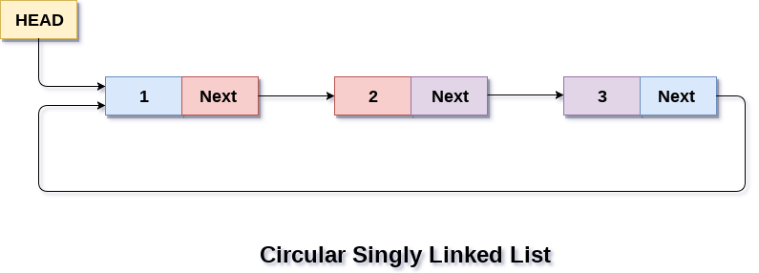

Slide 86
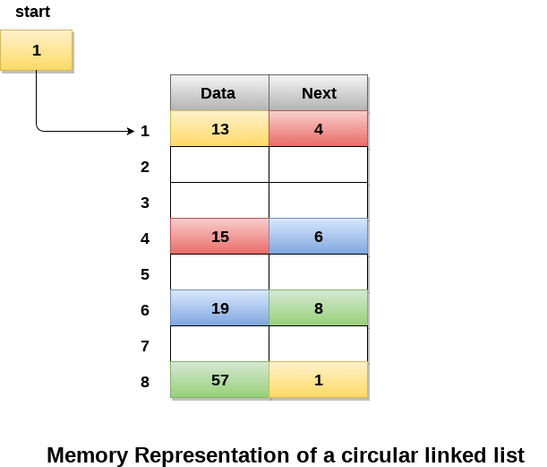
Memory Representation of circular linked list:

Slide 87
Opeartions
Insertion
Deletion
Traversing
Searching

Slide 88
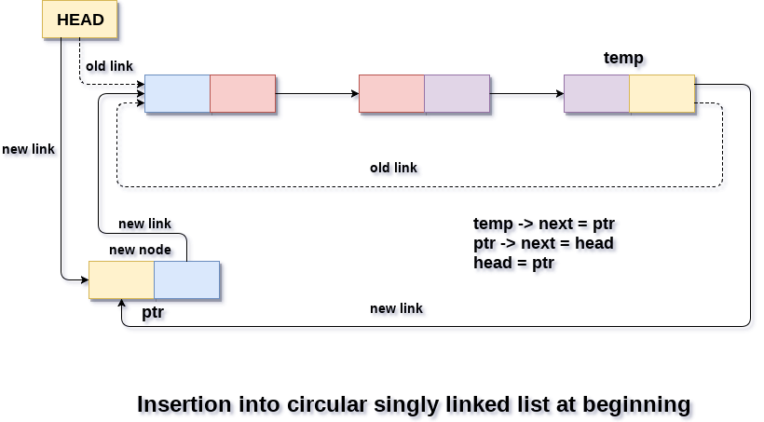
Insertion at start
There are two scenario in which a node can be inserted in circular singly linked list at beginning. Either the node will be inserted in an empty list or the node is to be inserted in an already filled list.

Slide 89
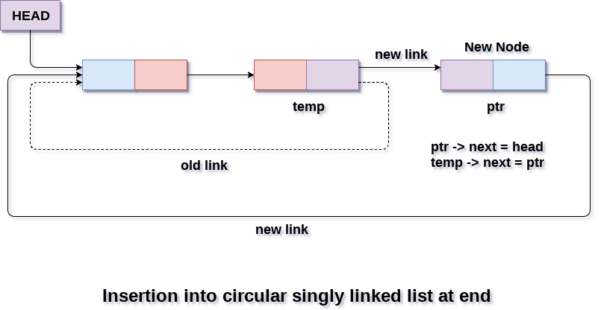
Insertion at end

Slide 90
Deletion
There are three scenarios of deleting a node from circular singly linked list at beginning.
  Scenario 1: (The list is Empty)
  Scenario 2: (The list contains single node)
  Scenario 3: (The list contains more than one node)

Slide 91
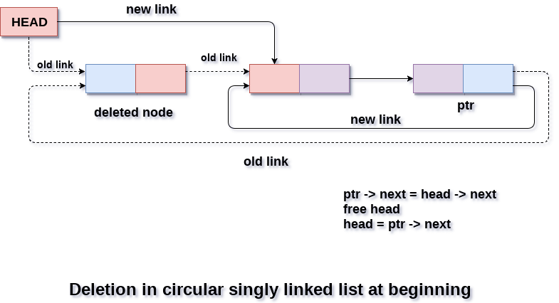
Deletion at beginnning

Slide 92
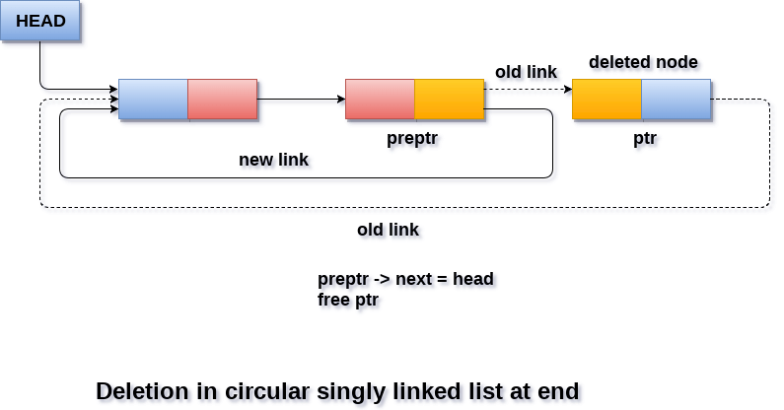
Deletion at end

Slide 93
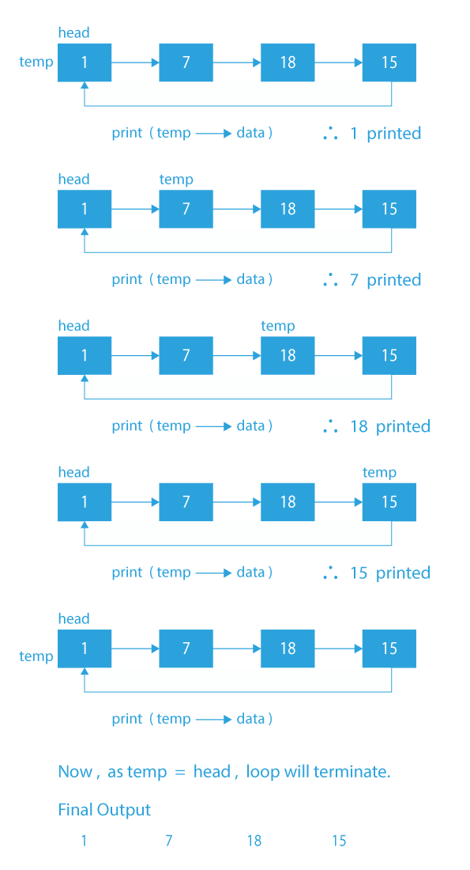
Traversing

Slide 94
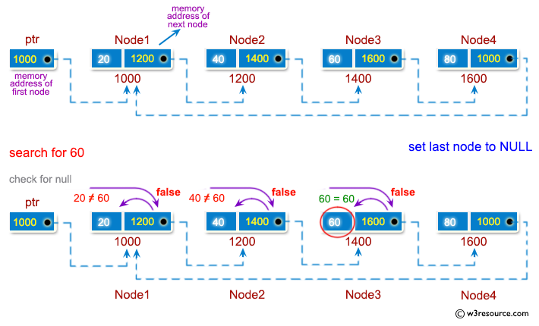
Searching

Slide 95
Best case time complexity
Data structure | Access | Search | Insertion | Deletion
Array | O(1) | O(1) | O(1) | O(1)
Stack | O(1) | O(1) | O(1) | O(1)
Queue | O(1) | O(1) | O(1) | O(1)
Singly Linked list | O(1) | O(1) | O(1) | O(1)
Doubly Linked List | O(1) | O(1) | O(1) | O(1)

Slide 96
Worst Case time complexity
Data structure | Access | Search | Insertion | Deletion
Array | O(1) | O(N) | O(N) | O(N)
Stack | O(N) | O(N) | O(1) | O(1)
Queue | O(N) | O(N) | O(1) | O(1)
Singly Linked list | O(N) | O(N) | O(N) | O(N)
Doubly Linked List | O(N) | O(N) | O(1) | O(1)

Slide 97
Average time complexity
Data structure | Access | Search | Insertion | Deletion
Array | O(1) | O(N) | O(N) | O(N)
Stack | O(N) | O(N) | O(1) | O(1)
Queue | O(N) | O(N) | O(1) | O(1)
Singly Linked list | O(N) | O(N) | O(1) | O(1)
Doubly Linked List | O(N) | O(N) | O(1) | O(1)

